Slide 1
AI-Driven Governance for Maharashtra
Maha Hackathon challenge 1.0
Name – Pranishraj Atul Nigade
Course – B.E. (Artificial Intelligence and Data Science)
Year – Third Year
Address – Pune, Maharashtra

Slide 2
Problem statement
Maharashtra’s governance spans 36 districts, urban & rural bodies with vast administrative functions.
Challenges:
Delays in decision-making due to manual processes.
Inefficient grievance redressal with slow response times.
Lack of predictive insights for planning and resource allocation.
Low transparency & accessibility in public services.

Slide 3
Solution overview
Multilingual AI for predictive governance & citizen services
Automation of public service delivery across key state portals (Aaple Sarkar, MahaDBT, etc.)
AI-powered predictive analytics for:
Disaster Response – Early warnings, risk assessment, and optimized resource deployment.
Water Management – AI-driven insights for Jalyukt Shivar Abhiyan to manage water conservation efforts efficiently.
Urban Planning – Smart Cities Mission optimization using AI for infrastructure, traffic, and waste management.

Slide 4
Key features & BENEFITs
Predictive AI for governance – Proactive decision-making in administration.
Automated Public Services – AI chatbots & automation for faster citizen responses.
Data-Driven Policy Making – AI-generated insights for better governance strategies.
Multilingual & Inclusive – AI models trained in multiple Indian languages.
Transparency & Accountability – AI ensures efficient monitoring & reporting.

Slide 5
Technology stacks
AI/ML : NLP-based AI for multilingual chatbot support, predictive analytics models.
Cloud & Database : AWS/GCP for scalable storage & computing.
Frontend : React for web dashboards & mobile-friendly interfaces.
Security : Blockchain-based logs for tamper-proof governance records

Slide 6
Expected impact
📉 Reduced administrative delays with AI-powered automation.
🔄 Efficient resource allocation through predictive analytics.
💬 Better citizen engagement with AI-driven chatbots & automated grievance redressal.
🌍 Sustainable urban & rural planning with AI-driven water & disaster management.

Slide 7
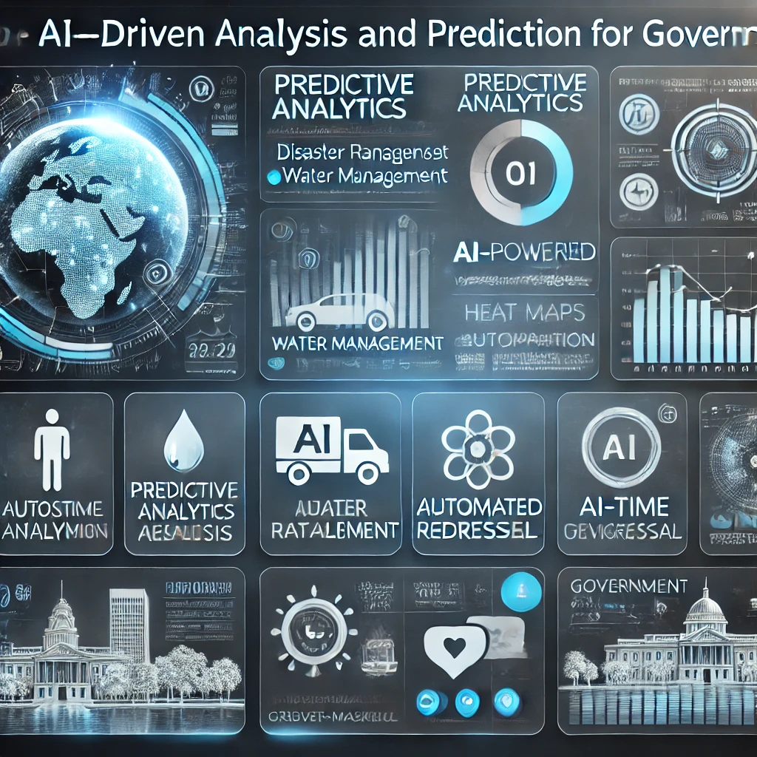
Demo image ( this is an AI based image)

Slide 8
conclusion
The integration of AI in governance presents a transformative opportunity for Maharashtra to enhance efficiency, transparency and responsiveness in public service delivery. By leveraging predictive analytics, automation, and multilingual AI, our solution addresses key challenges in disaster response, water management and urban planning.
Next Steps:
✅ Pilot testing with government departments for real-world validation. ✅ Integration with existing state databases for data-driven policy-making. ✅ Scalability to include AI-powered governance models in more administrative sectors. ✅ Collaboration with government bodies and technology partners for deployment.

Slide 9
THANK YOU

